Slide 1
Installation Instructions
Windows 8 http://mytechblog.com/tutorials/arduino/install-arduino-drivers-on-windows-8/
Windows 7, Vista, and XP
https://www.arduino.cc/en/Guide/Windows#toc4

Slide 2
Plug in your board and wait for Windows to begin it's driver installation process. After a few moments, the process will fail, despite its best efforts
Click on the Start Menu, and open up the Control Panel.
While in the Control Panel, navigate to System and Security. Next, click on System. Once the System window is up, open the Device Manager.
Look under Ports (COM & LPT). You should see an open port named "Arduino UNO (COMxx)". If there is no COM & LPT section, look under "Other Devices" for "Unknown Device".
Right click on the "Arduino UNO (COmxx)" port and choose the "Update Driver Software" option.
Next, choose the "Browse my computer for Driver software" option.
Finally, navigate to and select the driver file named "arduino.inf", located in the "Drivers" folder of the Arduino Software download (not the "FTDI USB Drivers" sub-directory). If you are using an old version of the IDE (1.0.3 or older), choose the Uno driver file named "Arduino UNO.inf"
Windows will finish up the driver installation from there.

Slide 3
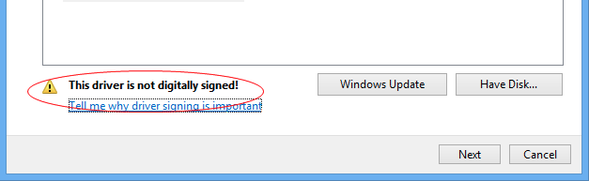
To do this, open the charms bar and click Change PC Settings. Then go to General and under Advanced Startup and click Restart Now.
When the computer starts up click Troubleshoot
Then Advanced Options
From the next menu select Startup Settings and then Restart
The screen displayed allows you to “Disable driver signature enforcement” by pressing key 7.
Wait for the computer to restart and follow through the Arduino’s instructions again. You will be presented with a security warning when installing the drivers.
Click Install this driver software anyway and the installation will continue.

Slide 5
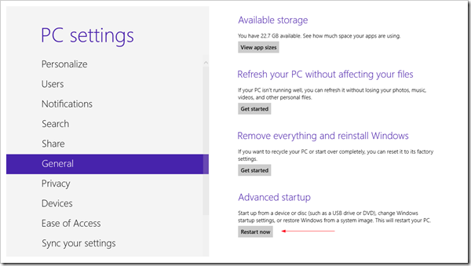
To do this, open the charms bar and click Change PC Settings. Then go to General and under Advanced Startup and click Restart Now.

Slide 6
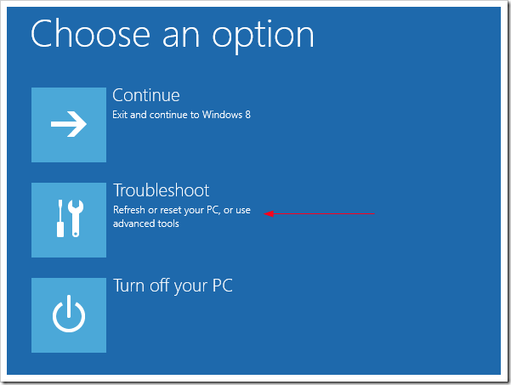
When the computer starts up click Troubleshoot

Slide 7
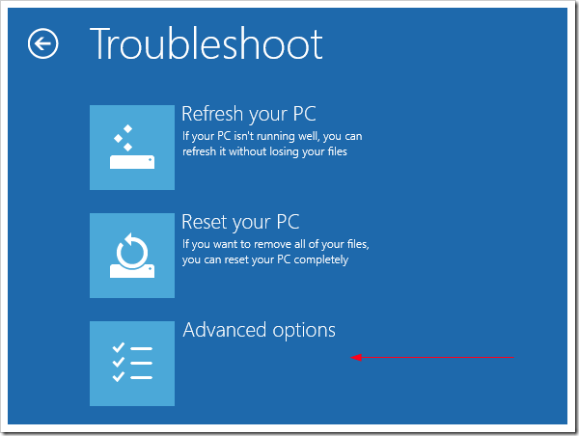
Then Advanced Options

Slide 8
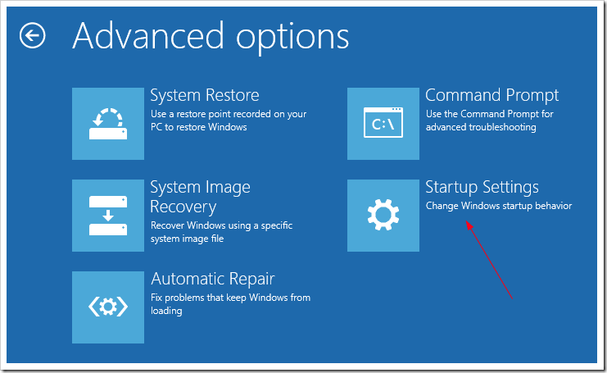
From the next menu select Startup Settings and then Restart

Slide 9
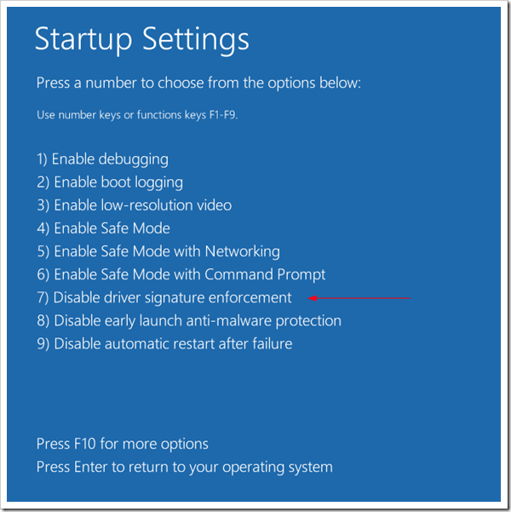
The screen displayed allows you to
“Disable driver signature enforcement” by pressing key 7.

Slide 10
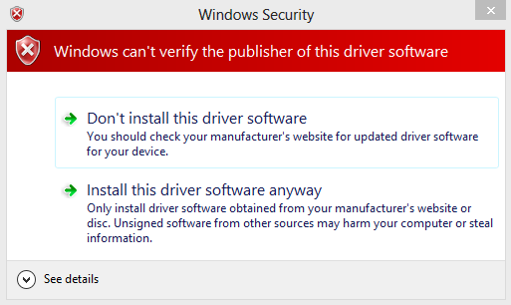
Wait for the computer to restart and follow through the Arduino’s instructions again.
You will be presented with a security warning when installing the drivers.
Click Install this driver software anyway and the installation will continue.

Slide 11

Interactive Posters
Capacitive Sensing with Arduino

Slide 12
What does Codasign do?

Slide 13


Slide 14
What is an Arduino?

Slide 15
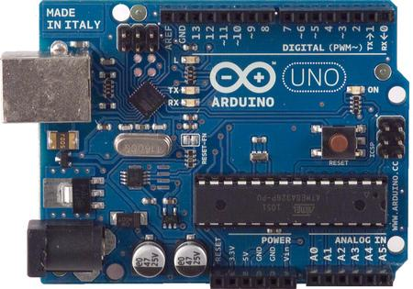
Description of Arduino
Arduino is an open-source electronics prototyping platform based on flexible, easy-to-use hardware and software. It's intended for artists, designers,
hobbyists, and anyone interested in creating interactive objects or environments.

Slide 16
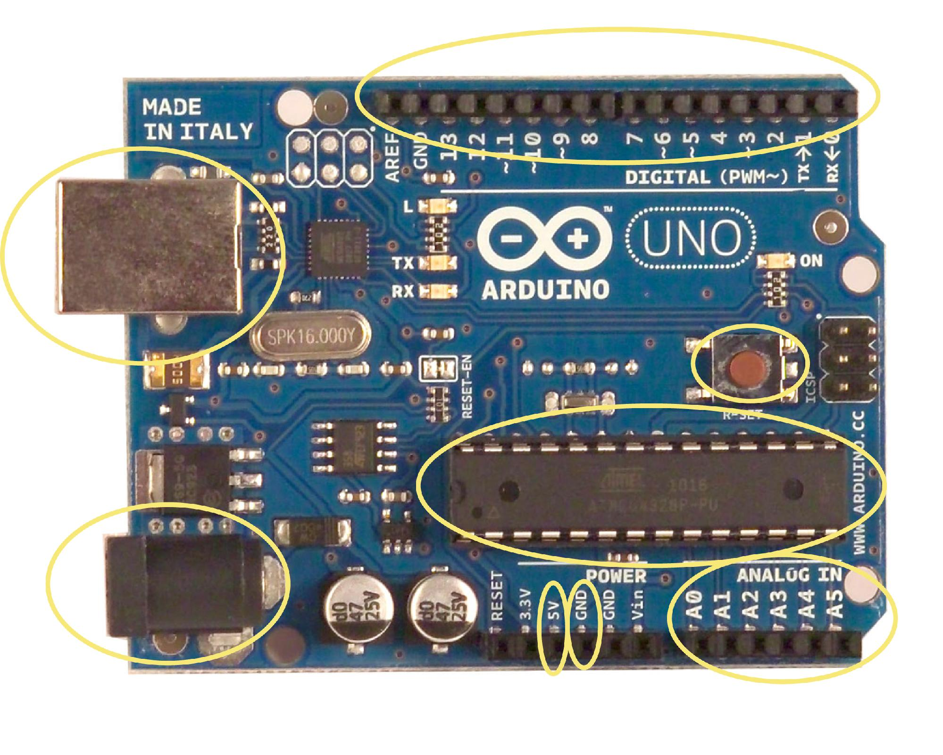
Arduino diagram8

Slide 17
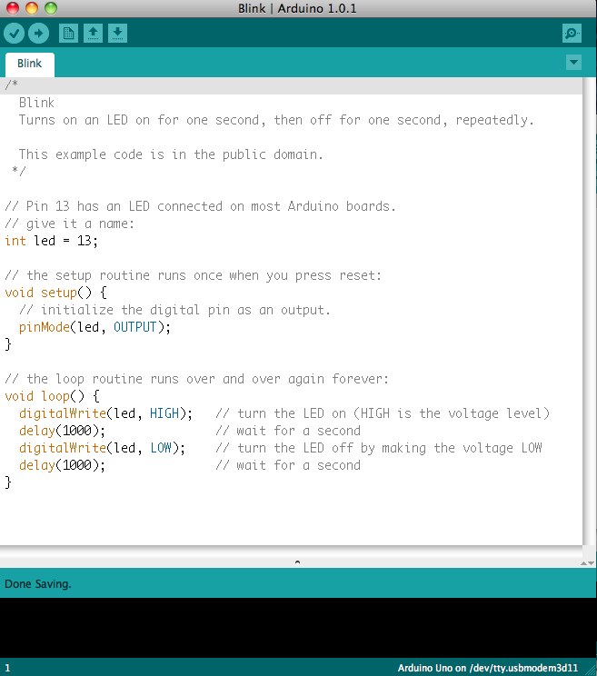
Description of Arduino
Arduino Programming Environment
The Arduino software is also open-source. The source code for the Java environment is released under the GPL and the C/C++ microcontroller libraries are under the LGPL.

Slide 18
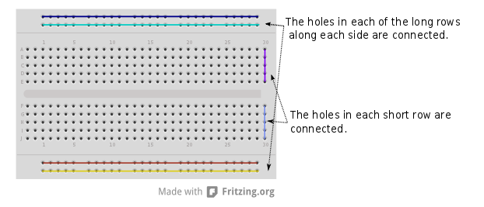
Breadboard Layout

Slide 19
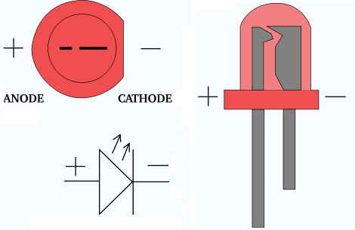

Light Emiting Diode
Notes:
Ground – cathode = cat like to lie on the ground
*

Slide 20
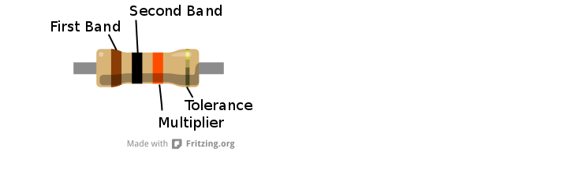
Resistor
They reduce the current that flows across them and are
useful for making sure other components aren't overloaded
with too much current.

Slide 21
Potentiometer & LED Fade

Slide 22
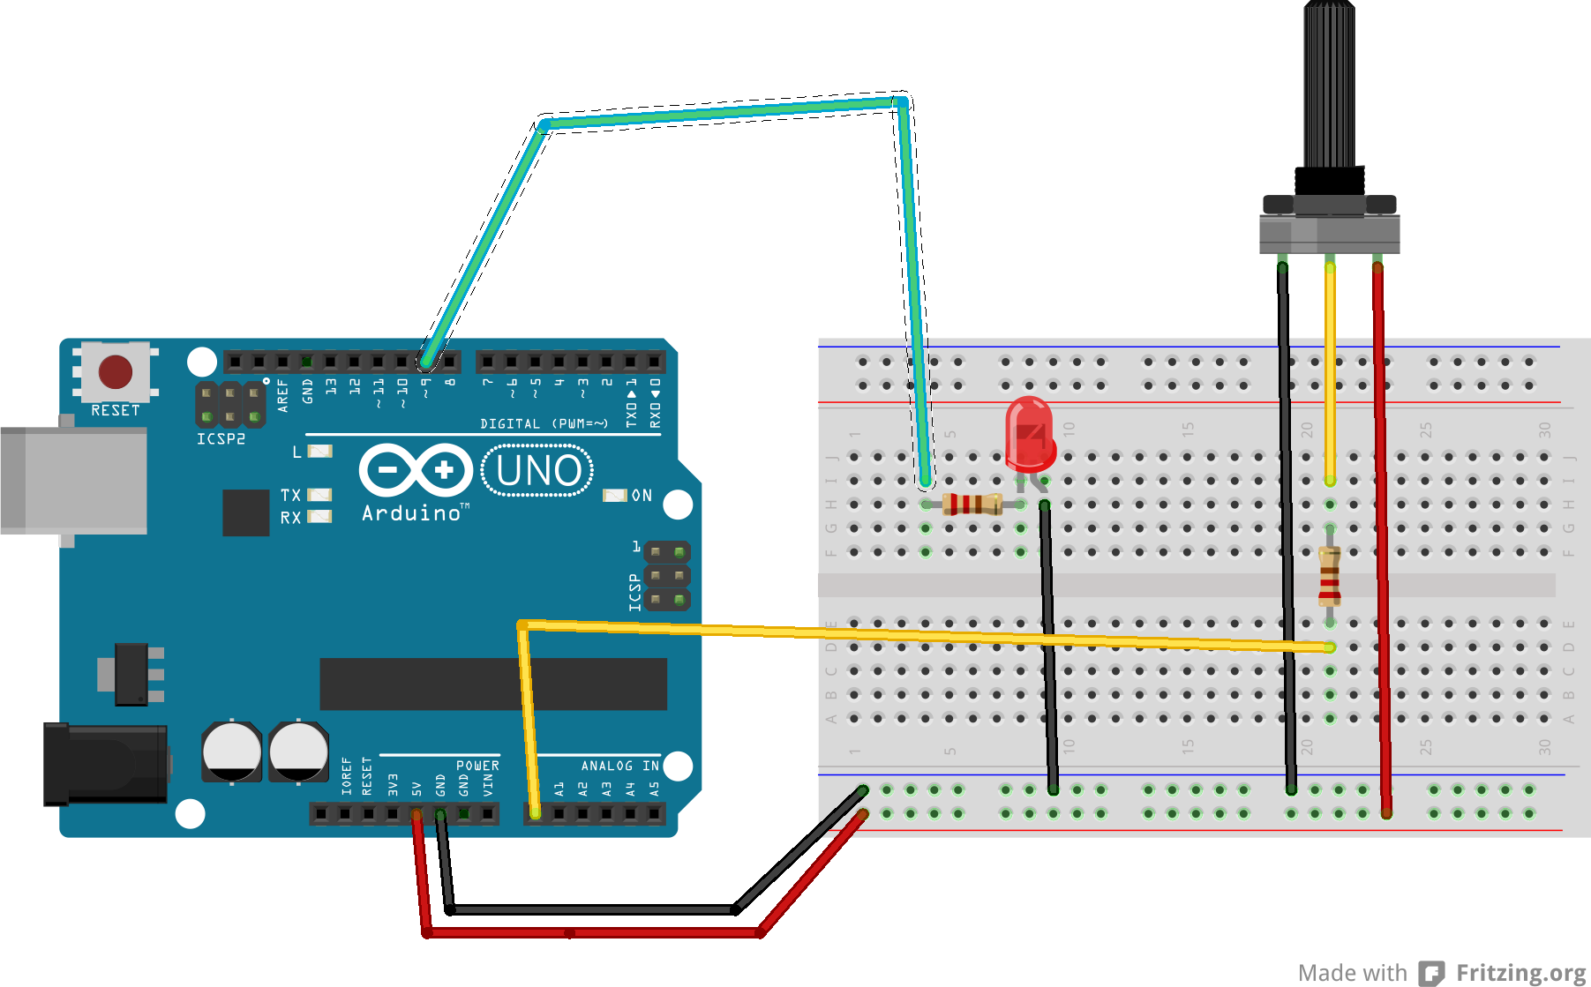

Slide 23
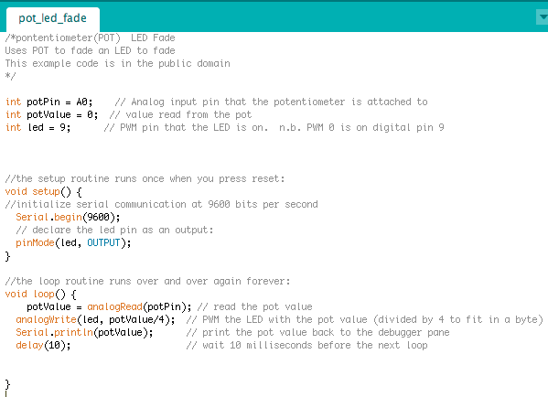

Slide 24
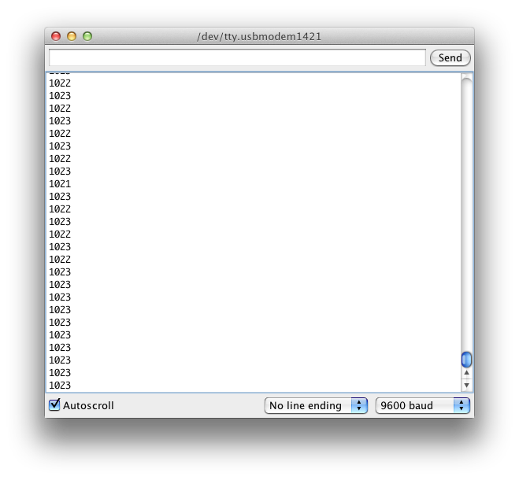
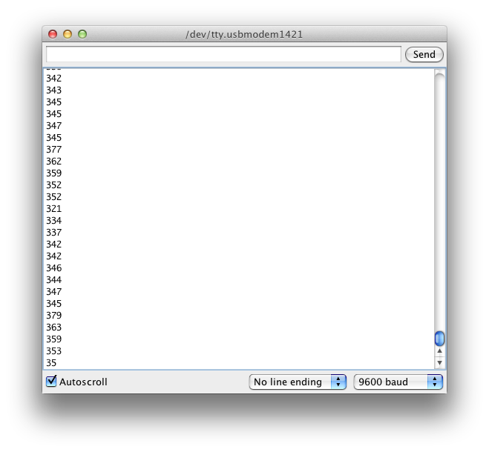
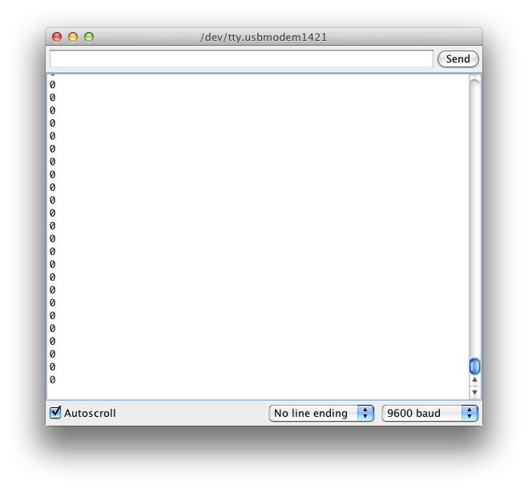

Slide 25
Photo Resistor & LED

Slide 26
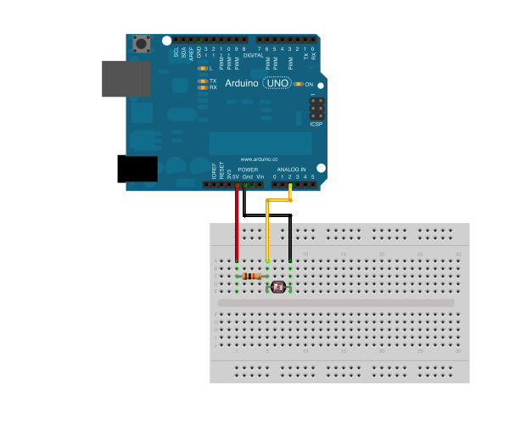

Slide 27
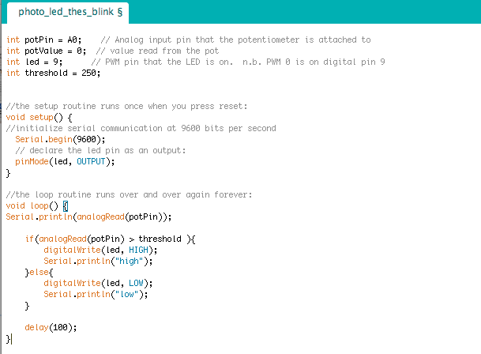

Slide 28
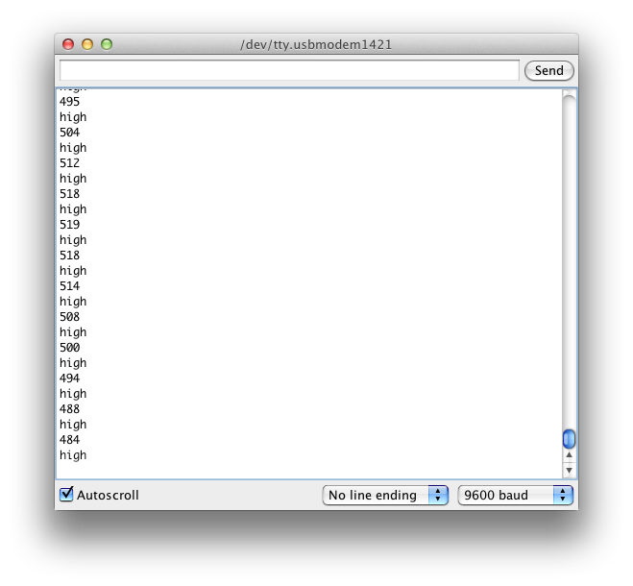
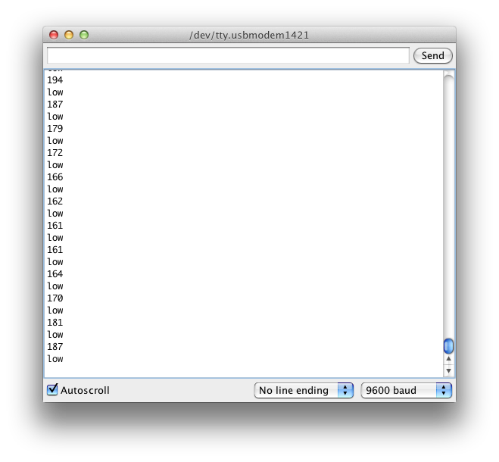

Slide 29
Capacitive & LED

Slide 30
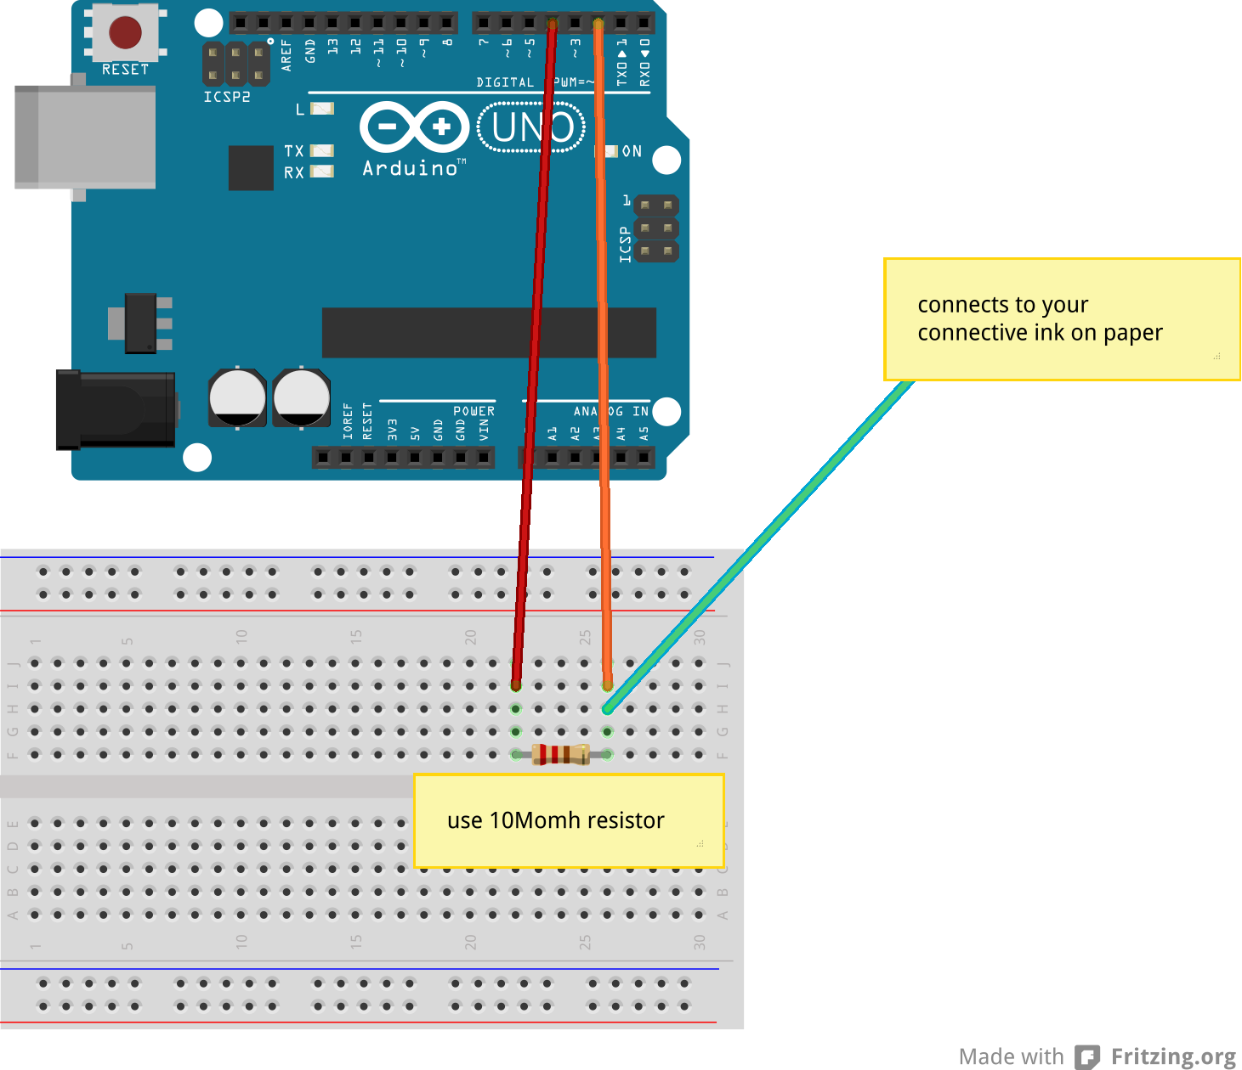
connects to your
tin foil

Slide 31
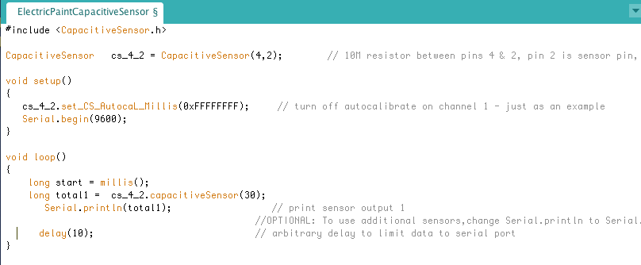

Slide 32
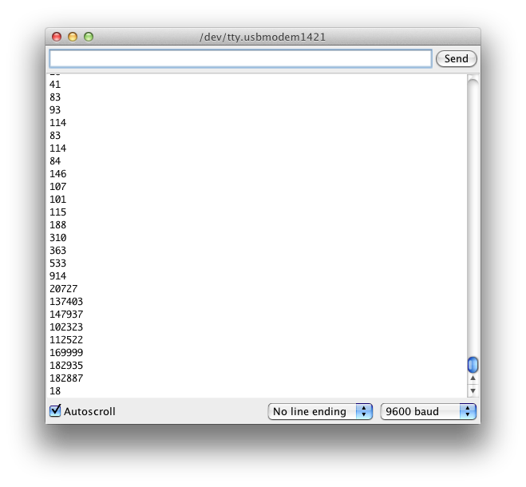
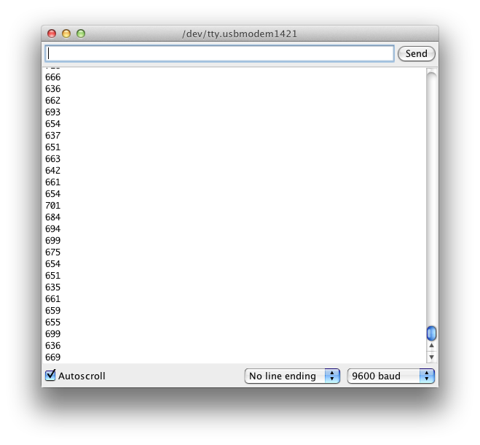
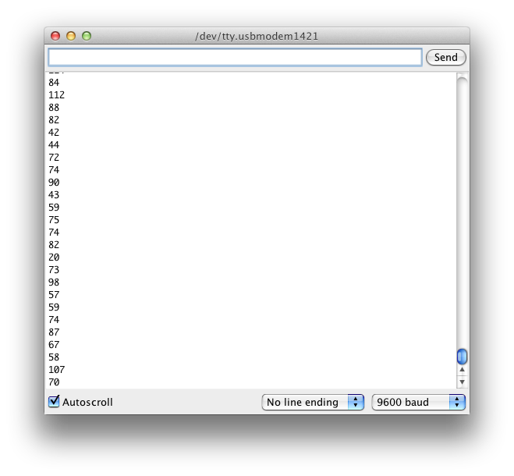

Slide 33
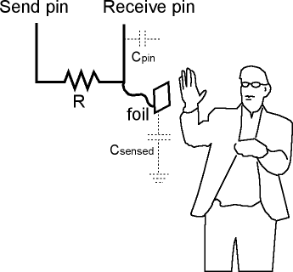
Pin 4
Send pin
Pin 2
Receive pin
1. SEND pin moved to a new state
2. waits for the RECEIVE pin to change
3. reports the variable's value
which is in arbitrary units.

Slide 34
Capacitive & Piezo

Slide 35
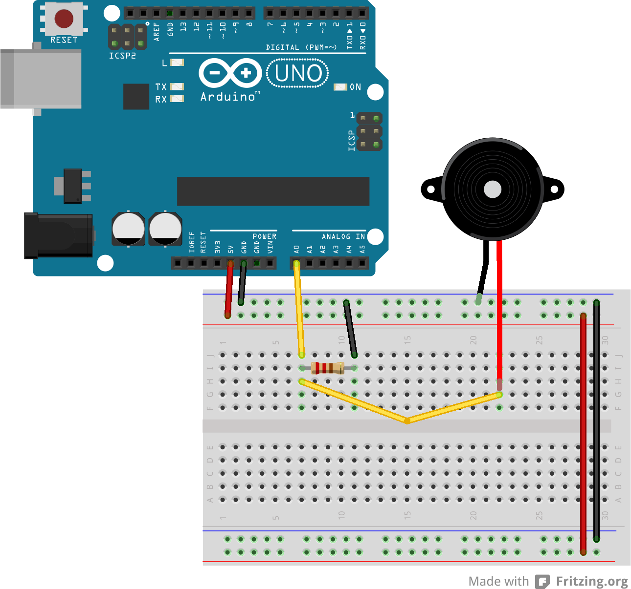

Slide 36
END
www.codasign.com
Info@codasign.com
@codasign

Slide 37
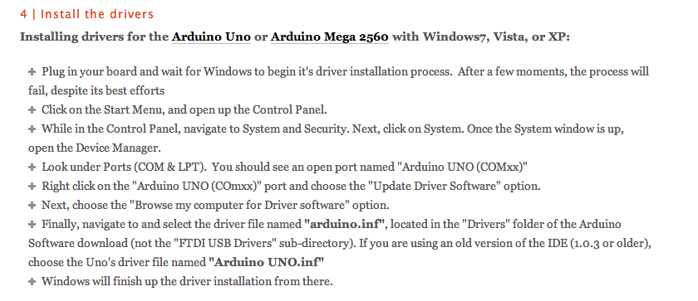
END
Windows install guide
http://arduino.cc/en/Guide/windows
Windows step by step
http://arduino.cc/en/Guide/UnoDriversWindowsXP

